Slide 1
A trip down the North Kerry line…..
……..curioser and curioser…..

Slide 7
Curioser and curioser….

Slide 9
The Great Southern Trail
Since 1988, has been campaigning to preserve the track bed as a long distance walking and cycling route.
Currently surfaced with bridges restored and sign boards from Rathkeale to the Kerry/Limerick border
Working now on extensions to Tralee, linking with proposed Fenit greenway

Slide 11
Limerick, 1959

Slide 12
Limerick, 1959

Slide 14
Limerick, 1958

Slide 15
Limerick, 1958

Slide 16
Limerick Check 1955

Slide 17
Carey’s Road, 1955

Slide 18
Castlemungret, 2000

Slide 19
? Patrickswell

Slide 20
Patrickswell, 1904

Slide 21
164, Limerick-Cork goods, 1955

Slide 22
186, 1964 rail tour

Slide 23
Kilgobbin, 1955

Slide 24
Maigue River bridge, Adare

Slide 25
Adare, 1958

Slide 26
Adare

Slide 27
Ballingrane, c. 1930

Slide 28
Ballingrane, June 1973

Slide 29
Ballingrane, 1958

Slide 30
Askeaton, 1955

Slide 31
Askeaton, 1955

Slide 32
Anyone for Foynes, 1955?

Slide 33
Foynes, 1955

Slide 34
Foynes, 1955

Slide 36
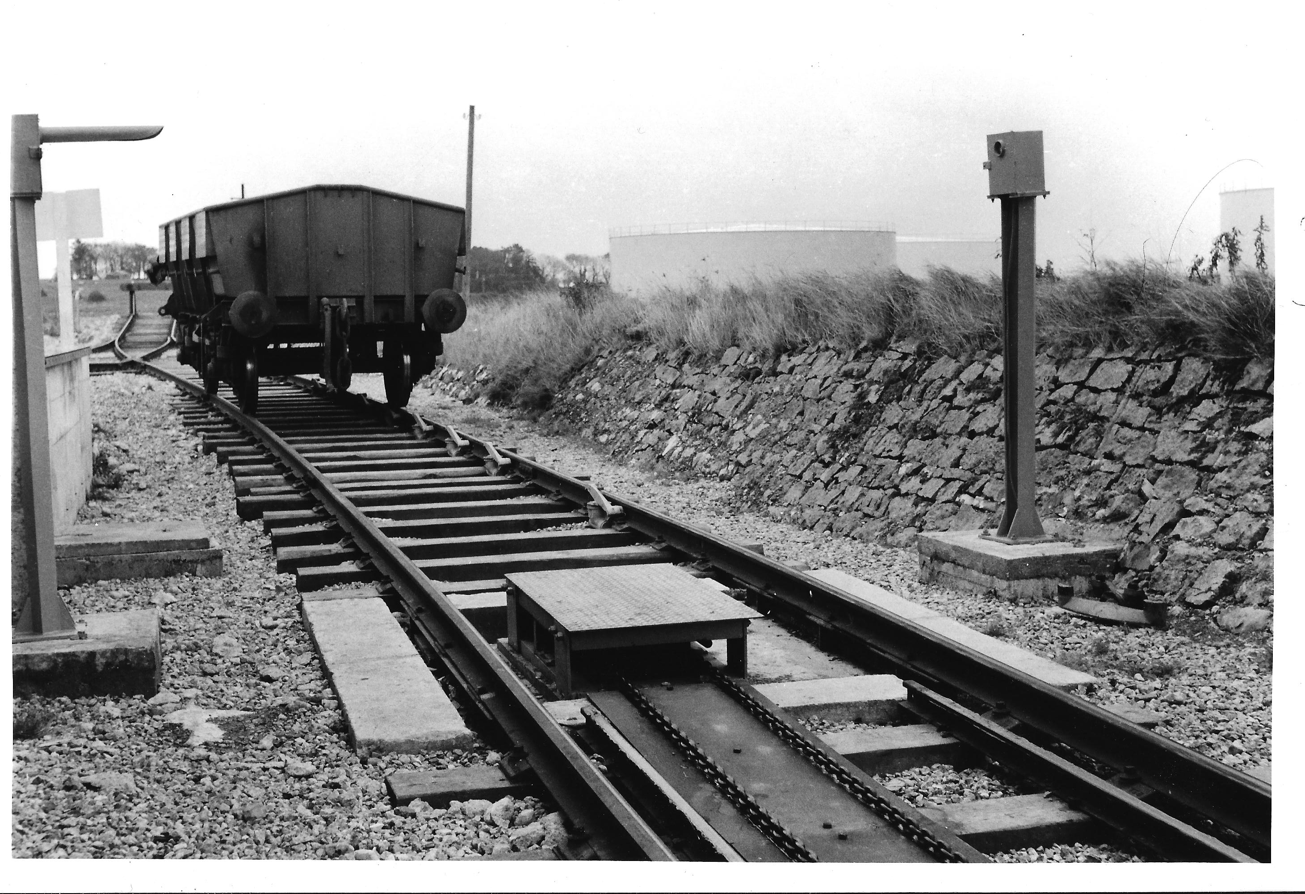

Slide 37
Available from Liam O Mahony: lomahony@hotmail.com or by text/WhatsApp to 00353876471956. Payment by bank notes or cheques payable to “Liam O Mahony,” at 9 Bishop Street, Newcastle West, Co. Limerick, V42HT66, Ireland. If purchasing both books payment is €35/£35stg. All prices include postage to the UK or Ireland.
The North Kerry Line €25/£25stg. Please text/e-mail and await confirmation of availability before forwarding payment and address, as only ten copies remain
Limerick and Kerry Railway: Twilight Years €15/£15stg.

